Slide 1
Computer Architecture Concepts
Part 21 – MIPS Branch instructions

Slide 2
Objectives
We have already seen jump instructions to change the flow of a program
jal label
jr register
These allowed us to pass the program control to a subroutine
Now we will look at other instructions for changing program flow – branch instructions (still using labels)

Slide 3
Branching
Allows conditional changes in execution path
Then we can code if/else type statements and loops
Based on some condition we either continue on the code path or move to a different part of the program
There are many different variations of branch instructions in MIPS basic and pseudo-instructions. We will only look at a few of them.

Slide 4
Branch instructions in MIPS
Branch always
b, label
Branch greater than zero
bgtz, register, label
Branch not equal to zero
bnez, register, label

Slide 5
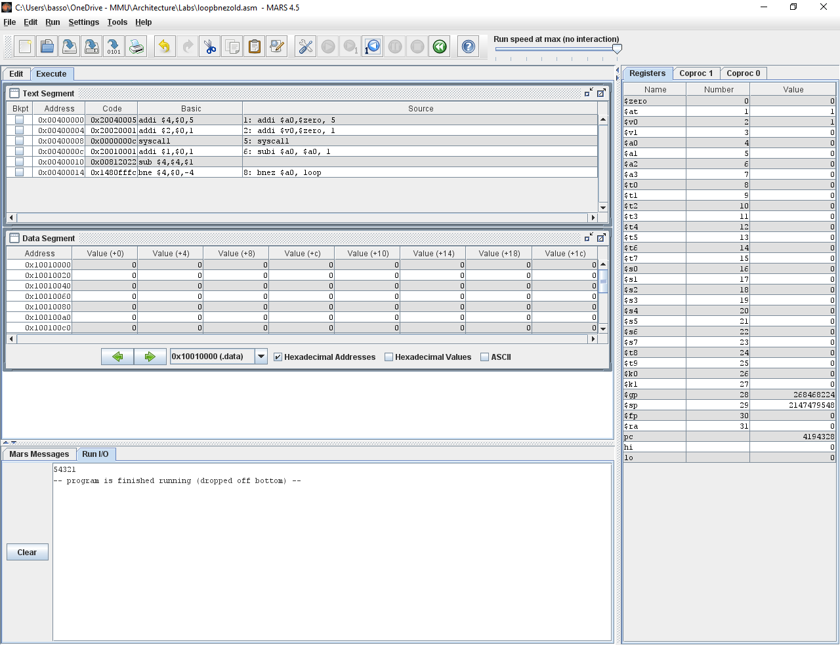
Creating a countdown loop
addi $a0,$zero, 5
addi $v0,$zero, 1
loop:
syscall
subi $a0, $a0, 1
bnez $a0, loop

Slide 6
Making decisions
Suppose we want the user to input their mark and the program will tell them if it’s a pass or a fail
We can subtract 39 from the mark
If the result is greater than 0 then it is a pass
Otherwise it is a fail
We will assume that the user inputs an integer in the correct range (0 to 100)

Slide 7
if then else
.data
msgPass: .asciiz "You passed, well done"
msgFail: .asciiz "You failed this time"
.text
addi $v0, $zero, 5
syscall
addi $v0, $v0, -39
bgtz $v0, pass
la $a0, msgFail
b output
pass:
la $a0, msgPass
output:
addi $v0, $zero, 4
syscall
Note that it will continue to the instruction after the bgtz when the value is not greater than zero

Slide 8
Summary
We have had a brief look at some of the branch instructions available in MIPS assembly language

